Slide 1
Question Parts
?
<
>

Slide 2
Information Parts
!

Slide 3
Animation Parts

;

⬅
4
➔



Slide 4
Player HUD
<
>

Slide 5
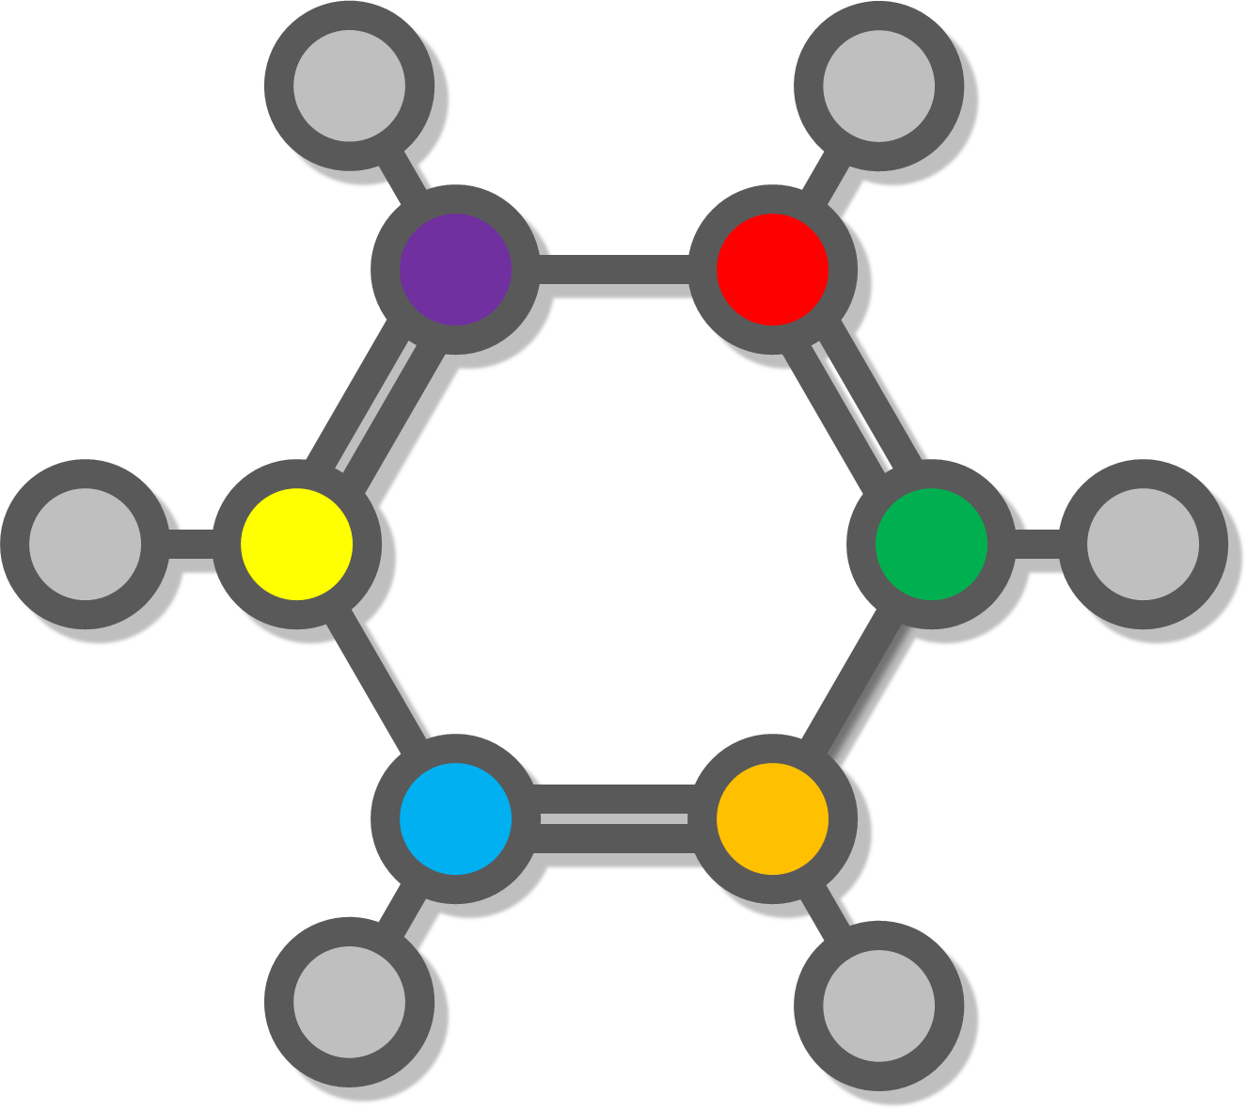
Icon

